Slide 1

AMOS taking your research to the next level
Mara Timofe
Research Intern

Slide 2
SEM – what & why?
SEM = Structural Equation Modeling
a statistical technique for testing and estimating causal relations using a combination of statistical data and qualitative causal assumptions.
Using SEM, you can quickly create models to test hypotheses and confirm relationships among observed and latent variables – moving beyond regression to gain additional insight.

Slide 3
What is the aim of AMOS?
Build structural equation models (SEM) with more accuracy than standard multivariate statistics models using intuitive drag-and-drop functionality.

Slide 4

What are the advantages of using it?
Quickly build graphical models using IBM SPSS Amos’ simple drag-and-drop drawing tools
Its rich, visual framework lets you to easily compare, confirm and refine models
builds models that more realistically reflect complex relationships
Its approach to multivariate analysis encompasses and extends standard methods

Slide 5

Fields
Psychology
  Develop models to understand how drug, clinical, and art therapies affect mood

Slide 6

Medical and healthcare research
  Confirm which of three variables –confidence, savings, or research – best predicts a doctor’s support for prescribing generic drugs

Slide 7
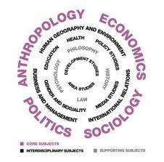
Social sciences
  Study how socioeconomic status, organizational membership, and other determinants influence differences in voting behavior and political engagement

Slide 8

Educational research
  Evaluate training program outcomes to determine impact on classroom effectiveness

Slide 9

Market research
  Model how customer behavior impacts new product sales or analyze customer satisfaction and brand loyalty

Slide 10

Institutional research
  Study how work-related issues affect job satisfaction

Slide 11

Business planning
  Create econometric and financial models and analyze factors affecting workplace job attainment

Slide 12

Program evaluation
  Evaluate program outcomes or behavioral models using SEM to replace traditional stepwise regression

Slide 13
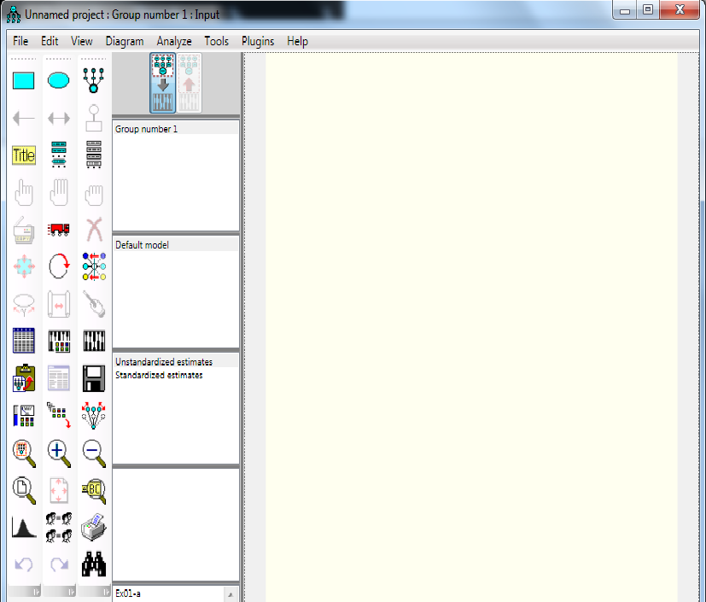
How it looks like

Slide 14
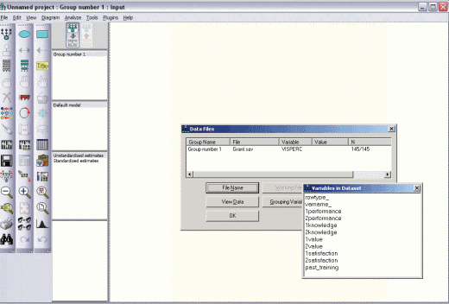
How does it work?
Select a data file
  Input data from a variety of file formats (IBM® SPSS® Statistics, Micosoft® Excel, text files, or many others). Select grouping variables and group values. IBM SPSS Amos also accepts data in a matrix format if you’ve computed a correlation or covariance matrix

Slide 15
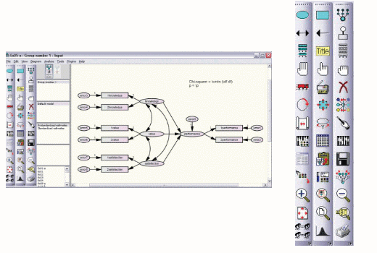
2. Specify your model
Use drag-and-drop drawing tools to quickly specify your path diagram model. Click on objects in the path diagram to edit values, such as variable names and parameter values. Or simply drag variable names from the variable list to the object in the path diagram to specify variables in your model.

Slide 16
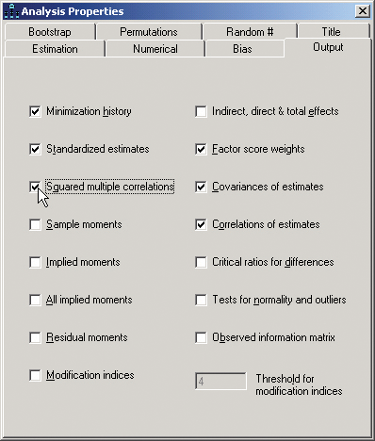
3. Select analysis properties
Select the analysis properties you wish to examine, such as standardized estimates of parameters or squared multiple correlations. Constrain parameters for more precise models by directly specifying path coefficients.

Slide 17
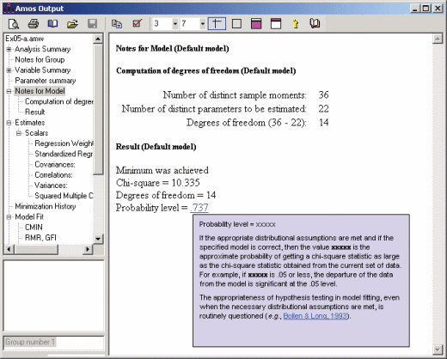
4. View output
BM SPSS Amos output provides standardized or un-standardized estimates of covariances and regression weights as well as a variety of model fit measures. Hotlinks in the help system link to explanations of the analysis in plain English.

Slide 18
THANK YOU!
☺

